Slide 1
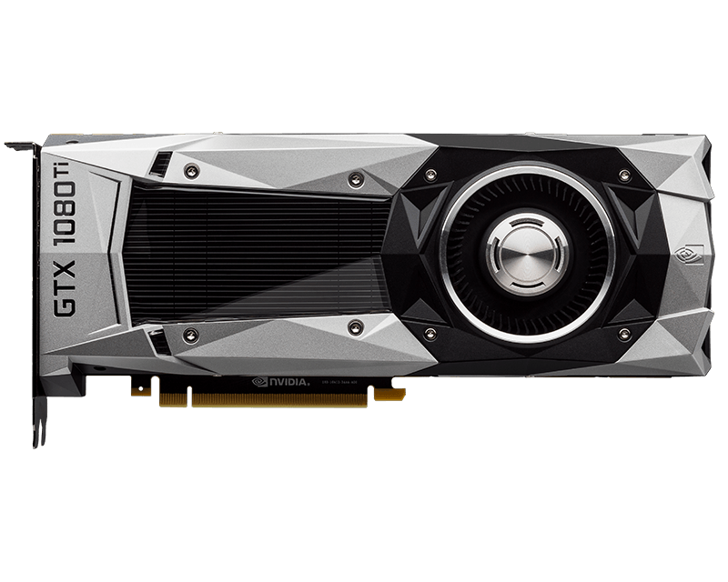
Nvidia GTX 1080 Ti
Notes:
Leo, Joakim, Aleksi

Slide 2
GPU
-Stands for: Graphical Processing Unit (GPU)
-Made for processing images on screen
-Optimised to do one task
-Has thousands of cores vs couple in CPUs
Notes:
Leo, Joakim, Aleksi

Slide 3
Nvidia GTX 1080 Ti
-Nvidia Flagship GPU
-3rd Most powerful GPU on the market (or would be if not sold out)
Notes:
Leo

Slide 4
Specifications
Nvidia GTX 1080 Ti
Size (Asus): 29.8 x 5.25 x 13.4 cm
Price (Asus): 900e
GPU architecture: Pascal
Memory: 11 Gt GDDR5X
Nvidia CUDA Cores 3584
AMD RX Vega 64
Size (Asus): 37 cm x 7 cm x 22 cm
Price (Asus): 880e
GPU architecture: GCN 5th Gen
Memory: 8Gt HBM2 2048-bit
Stream Processors 4096
Notes:
Leo

Slide 5
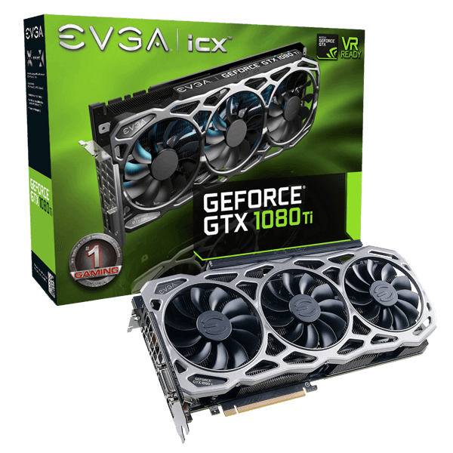
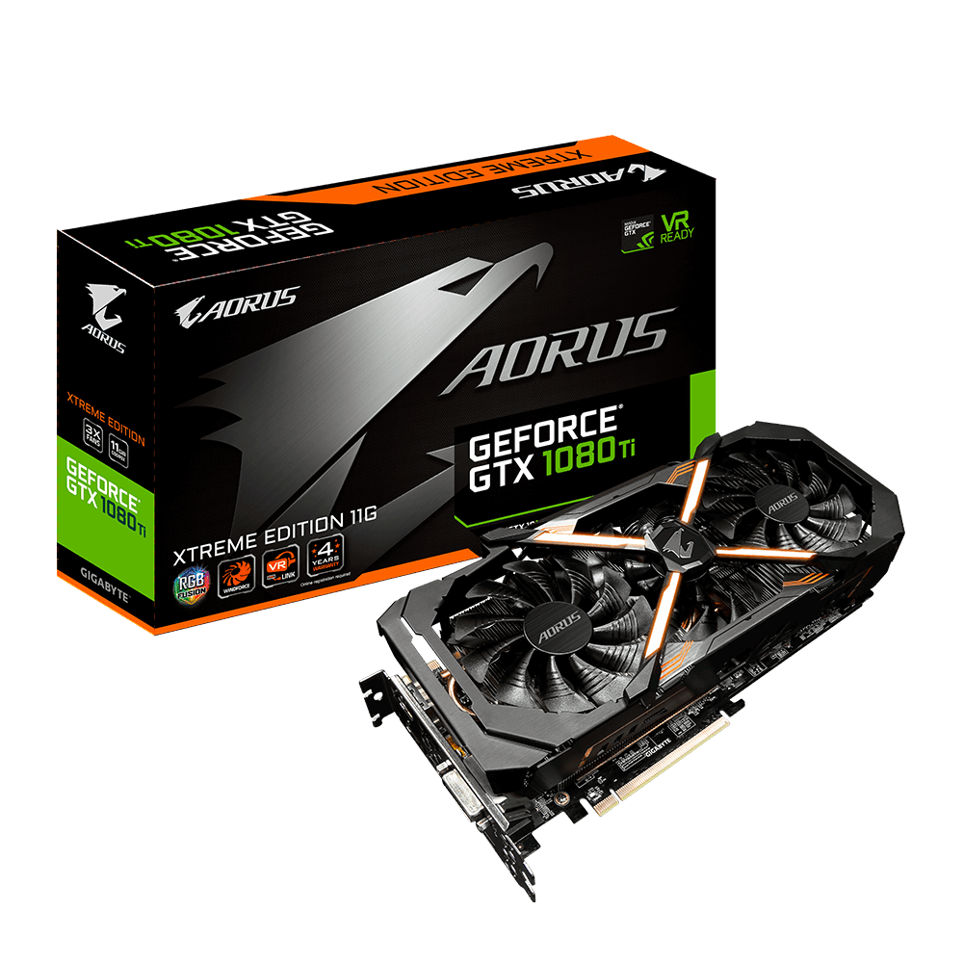
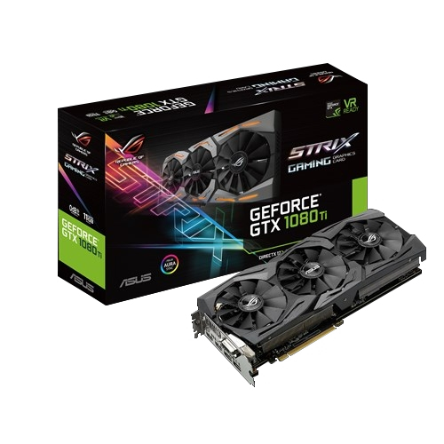
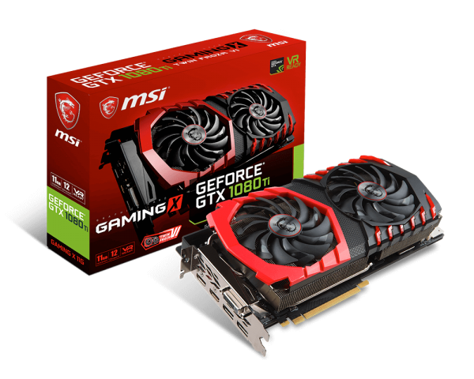

EVGA
EVGA GeForce GTX 1080 Ti FTW3 GAMING
GPU Boost Clock
1683MHz
Power Consumption
280W
AORUS
Gigabyte AORUS GeForce GTX 1080 Ti Xtreme Edition
GPU Boost Clock
1746MHz
Power Consumption
250W
MSI
MSI GTX 1080 Ti GAMING X TRIO
GPU Boost Clock
1683MHz
Power Consumption
250W
ASUS
ASUS ROG STRIX GeForce GTX 1080 Ti
GPU Boost Clock
1632MHz
Power Consumption
250W
Notes:
Leo

Slide 6
History
-Released in May 2016
-Has an MSRP of 699 USD
-Has the most capability in computing as a consumer graphics card in recent history
-Is the most popular high-end graphics card currently
-Pushes the limits of GPU performance

Slide 7
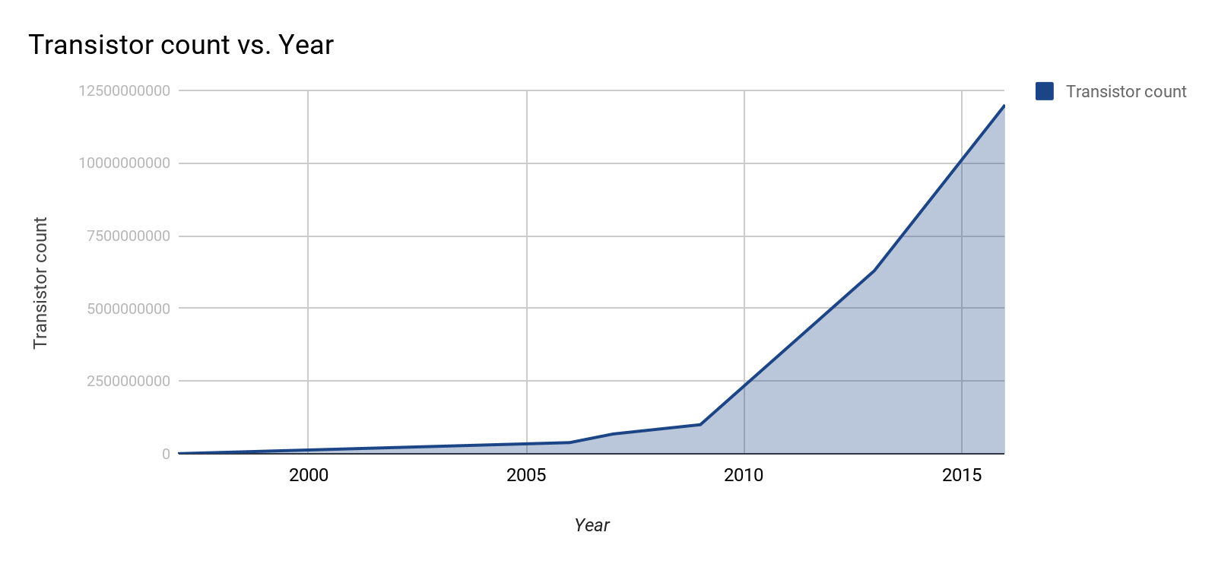
Moore’s Law

Slide 8
Comparisons
-One pixel is a dot on a monitor, where many of them together form a mosaic image
-In 1997, the Nvidia RIVA 128 filled 200 pixels in one second
-In 2006, the ATI Radeon X1950 Pro filled 6.9 billion pixels in one second
-In 2009, the ATI Radeon HD 4890 filled 13.6 billion pixels in one second
-In the present day, the Nvidia GTX 1080 Ti fills 130.2 billion pixels in one second

Slide 9
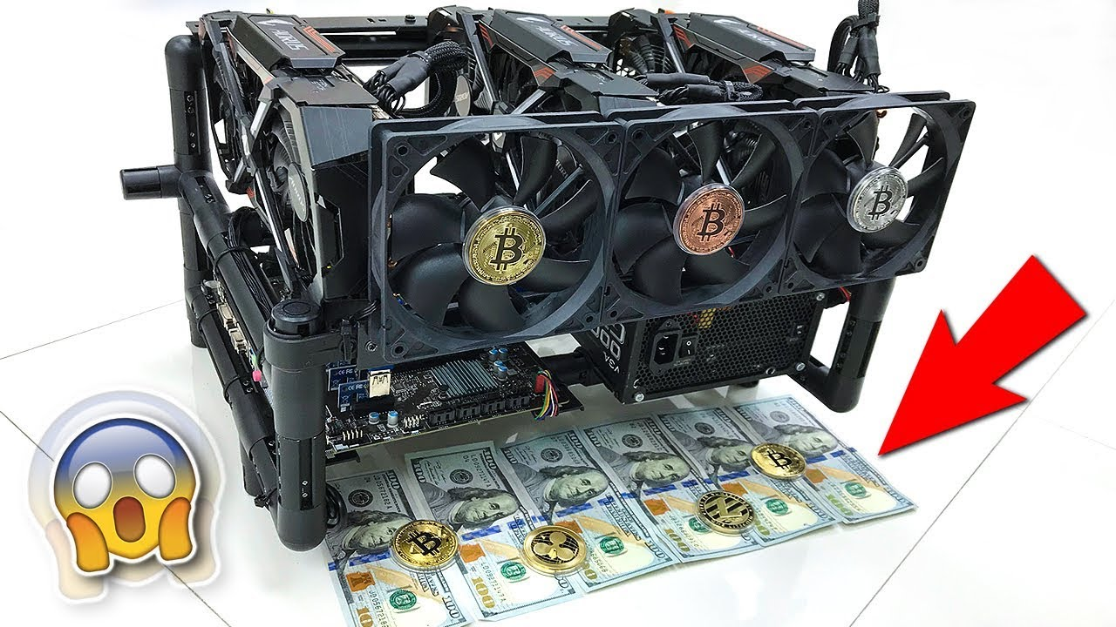
GPUs and Cryptocurrency
-What is cryptocurrency?
-What is cryptomining?
Notes:
Aleksi

Slide 10
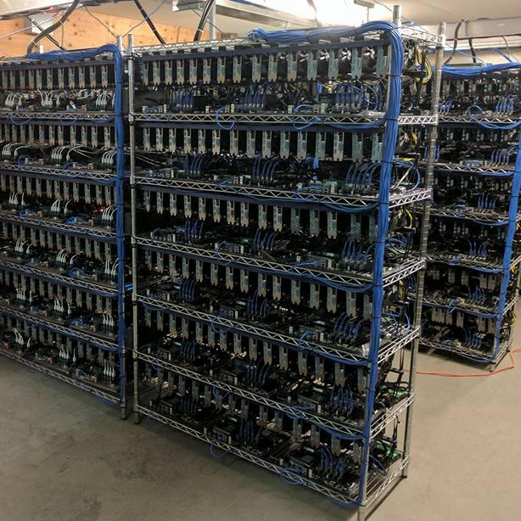
GTX 1080 Ti in mining
-Performs on par than AMD’s GPUs
-Mines about 120€ worth in a month
-Limits in availability causes increases in prices
Notes:
Aleksi

